Slide 1

Every Drop
Counts

Slide 2

Every Drop
Counts
Water Solutions for a
Sustainable Future
By
Muhammad Abdullah Elahi, XII
Mehnaz Khadim Hussain, XII
Aarij Ahmed Khan, XII
Khadija Batool, XI

Slide 3
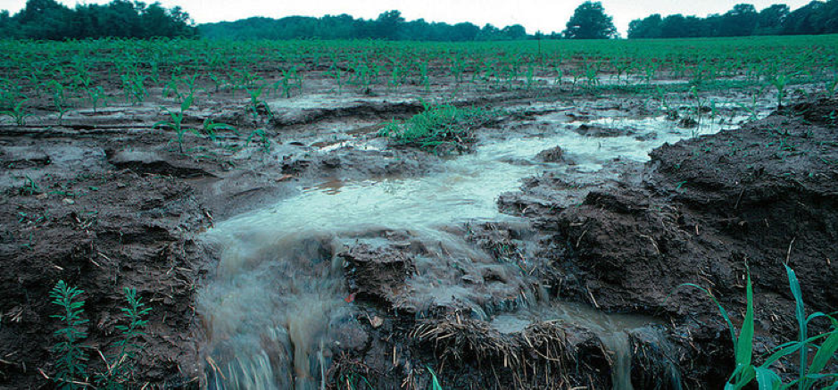

Climate change
Rainfall & its Wasteage
Water pollution plays a significant but often under-
discussed role in climate change
50-70% of the annual rainfall in Pakistan is either lost or goes unused.
Severe flooding, often referred to as “exceptional floods”, typically occurs once every 5-10 years.
Flooding, Soil Erosion & landslides, Drought Risk
Reduced CO2 Absorption: Warmer, polluted water
bodies and degraded ecosystems, like dead zones,
decrease the ocean's ability to absorb CO2,
intensifying global warming.
Thermal Pollution and Water Temperature Increase:
Industrial activities that use water as a coolant
discharge heated water back into rivers and oceans

Slide 4
Rainfall & its Wasteage
50-70% of the annual rainfall in Pakistan is either lost or goes unused.
Severe flooding, often referred to as “exceptional floods”, typically occurs once every 5-10 years.
Flooding, Soil Erosion & landslides, Drought Risk

Slide 5
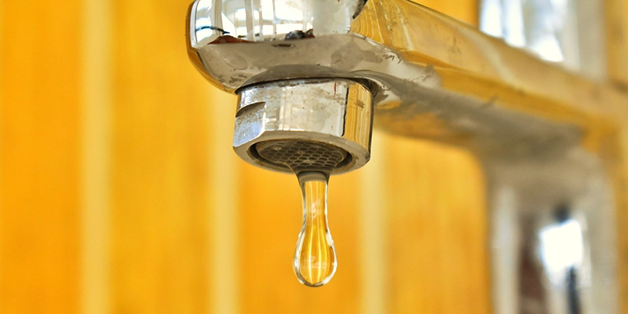
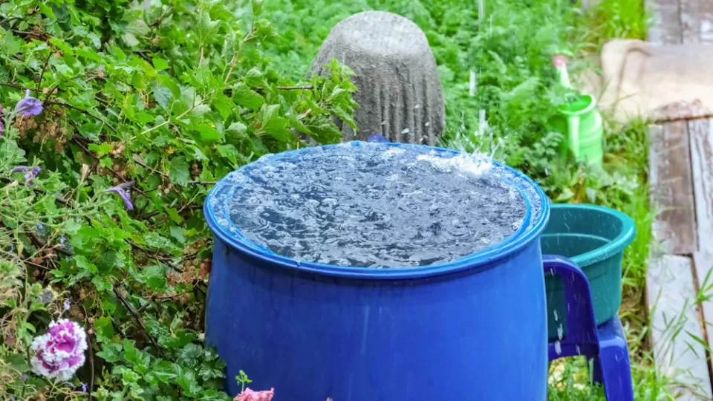
Home remedies to save water
Feasibility
Of Proposed Solutions
Cost-Effective
Water Source:
Environmental
Sustainability:
Low Maintenance
and Durability
Flexibility in Use
A
B
C
D
Fix any leaky faucets or pipes immediately.
Install water-saving fixtures like low-flow showerheads and faucets.
Only run washing machines and dishwashers with full loads.
Collect rainwater for watering plants and gardens.

Slide 6
Cost-Effective
Water Source:
Environmental
Sustainability:
Low Maintenance
and Durability
Flexibility in Use
A
B
C
D
Feasibility
Of Proposed Solutions

Slide 7
Feasibility
Of Proposed Solutions
Cost-Effective
Water Source:
Environmental
Sustainability:
Low Maintenance
and Durability
Flexibility in Use
A
B
C
D

Slide 8
Impact on Climate
Conservation of Ecosystems: Collecting rainwater and reducing excessive water usage helps maintain local water sources, preserving ecosystems that depend on natural water supplies. This balance supports biodiversity, which is crucial for climate resilience.
Waste Reduction: Only using appliances like dishwashers and washing machines with full loads minimizes wasteful cycles, reducing both water and energy waste.

